Slide 1
Funds transfer Message
Technical - Overview
Integration Team
July 2017

Slide 2
AGENDA
Overview
Structure Types
Logical Fields
Payment Data Object (aka PDO)
Samples

Slide 3
“
Standard interfaces were defined based on the Fndt Message structure to streamline the process of integrating GPP with various existing systems in a bank or financial institution”
Fndt Message Format – Technical Guide

Slide 4
FNDT Message in Payment Flow
<FndtMsg> from pain, pacs, SWIFT
FX Engine
<FndtMsg>
Internet Banking, Branch-OTC, SWIFT, Local Clearing
Receive Payment Instruction
Payment Initiation
Debit Side Processing
Credit Side Processing
<FndtMsg>
<FndtMsg>
<FndtMsg> to pain, pacs, SWIFT
Compliance
Account Lookup
SWIFT, Local Clearing
Posting
Balance Check
Fees Processing
MOP Selection Value Date and Cut Offs
<FndtMsg>
<FndtMsg>
Accounting System
Balance Inquiry

Slide 5

FndtMsg XML Sections
<FndtMsg>
<Header> general identifying attributes
<Msg> transaction message and extension
<Pmnt> payment quotes the transaction (ISO based pain, pacs or SWIFT within the GPP proprietary XML structure)
<Extn> GPP proprietary transaction attributes
<MsgFees> , <MsgNotes>, <MsgRates>, etc.
<OrigMsg> original message (ISO based pain, pacs or SWIFT within the GPP proprietary XML structure)
<ResponseDetails> applicable for Interface Responses
Note: The Inclusion and exclusion of specific tags and/or sub-tees of the full FNDT Message per such specific usage is done using system configuration in the XML_FORMAT_TYPE_RELATIONS table

Slide 6
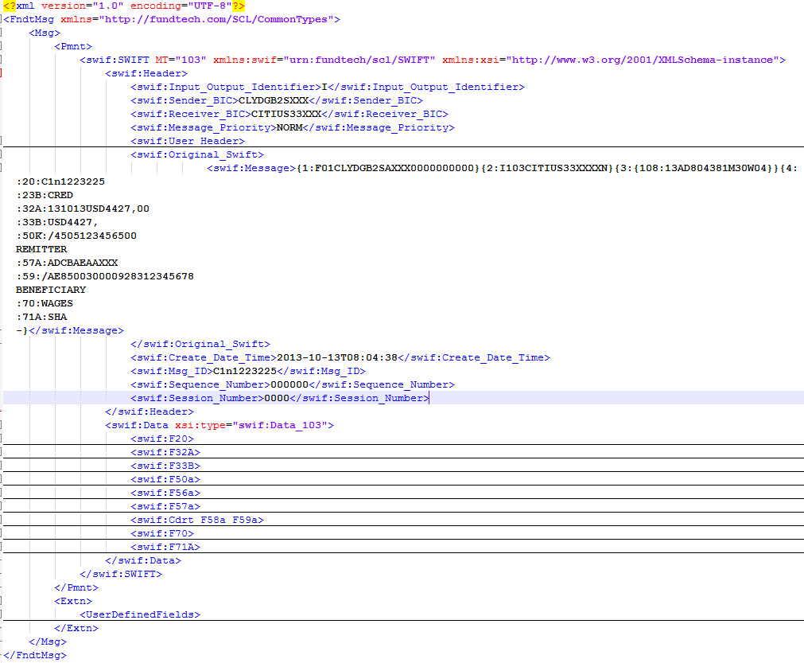
Fndt Msg - example
The illustration shows how SWIFT message accommodated in the Fndt message structure

Slide 7
Fndt Msg Batch XML sections
<FndtHeader> includes context information and credentials
<BatchHeader> contains the pain message <GrpHdr> element
<PmntTxInfo> transaction information that can include one debit (in the header) with multiple credit transfers that logically correspond to the /Document/CstmrCdtTrfInitn/PmtInf.
Note: This section can be repeated multiple times.
<PmntHeader> one debit wrapper that contains a /Document/CstmrCdtTrfInitn/PmtInf element, but excludes the <CdtTrfTxInf> elements
<TxInf> multiple credits section that contains a list of FndtMsg elements, one for each credit <CdtTrfTxInf> element.

Slide 8
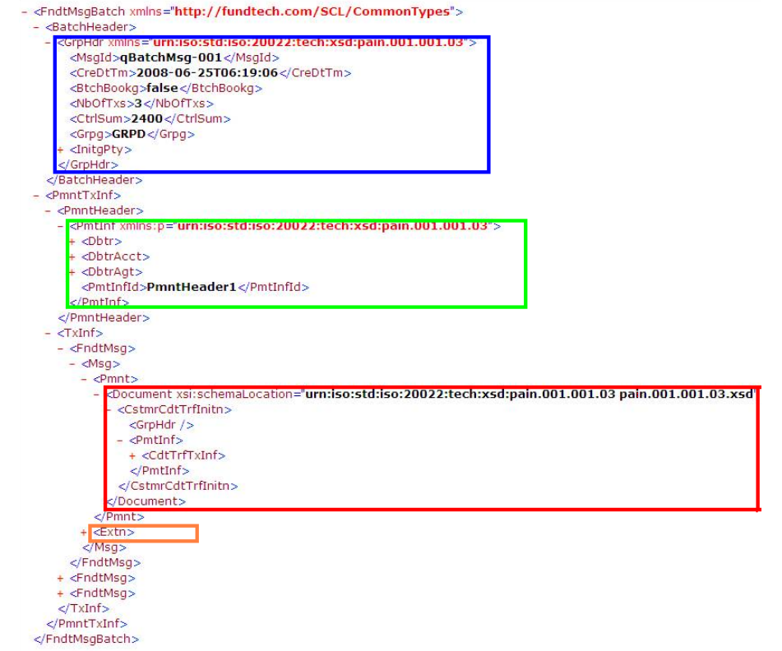
FndtMsgBatch - example
message header
The illustration shows how pain.001.001.03 sections are accommodated in the FNDT batch message structure while maintaining support for one debit with multiple credits.
batch header
payment header
payment content

Slide 9
Fndt Msg - header

Slide 10
transaction attribute fields
Explanation | Meaning | Prefix
Place holder in the tree view that hold the relevant associated information. Example: T_PARTIES holds all of the transaction parties | Tree | T_
ISO information that is stored in an XML structure in the XML_MSG | XML | X_
Copy of the originally received XML transaction () information that is stored in an XML structure in ORIG_XML_MSG | Original XML | OX_
Prefix used if there is more than one way to receive specific data. Example: OX_CDTR_AGT_BIC_1OR or OX_CDTR_AGT_BIC_2AND. GPP copies the data into OC_CDTR_AGT_BIC to facilitate determining whether creditor agent BIC was provided or not. Relevant only for originally received attributes. | Original Copy of XML field | OC_
GPP extension field for transaction data that cannot be placed in the ISO standard format. Examples of commonly used attributes: P_MID, P_OFFICE. | Process | P_
Derived attribute that are taken from the static data profile that is associated with transaction details. Examples: F_CDT_MOP_NM is the credit MOP name derived from the credit MOP value. F_MOP_NM is associated with the debit MOP. | GPP derived transaction attribute | F_
Derived attributes that are calculated ‘on the fly’ while the GPP service is calculating the information. Derived fields cannot be used as a condition in business rules as they are not stored. | Derived | D_
User monitors that track the user action over the user interface, such as, forcing a transaction out of the insufficient funds queue (filed P_USER_STATE_MONITOR with MU_ prefix ) Workflow monitors – internal monitors in the code that track the transaction processing flow (P_SERVICE_STATE_MONITOR with MF_ prefix ) Interface monitors that monitor interface interactions (P_INTERFACE_STATE_MONITOR with MI_ prefix ) | Monitor User Monitor Flow (service) Monitor Interface | MU MF MI

Slide 11
COMMON Behavior

Slide 12
Request Direction
Incoming interface type
GPP functions as the server: it gets the request and returns the response.
Outgoing interface type
GPP functions as the client: it sends the request and may or may not get a response.
‘I’ - incoming
GPP
GPP
‘O’ - outgoing

Slide 13
Interface model
Wait Behavior
Synchronous model
Valid for incoming and outgoing types. GPP waits for a response before continuing the flow.
Asynchronous model
GPP parks the payment in a certain ‘Wait status’, as defined in the interface metadata. When a response is accepted, flow continues.
Message Wait Status is status in which the message is parked while waiting for the response.
GPP
GPP
wait

Slide 14
Interface Status
Active status
GPP communicate thru the interface. This is the default status.
Not active status
GPP does not communicate thru the interface. Status is set automatically, when GPP identifies that there is a problem in communicating with the interface.
Stop After Connectivity Exception
Number of consecutive request transmission exceptions after which the interface is marked as inactive.
Note: Switch to active is done manually by a GPP user.
ACTIVE
GPP
NOT_ACTIVE
GPP

Slide 15
Contingency Mode
Not Active behaviour
STOP_UNTIL_ACTIVE
Do not create a request, stop the flow, and change the payment message status as defined in the ‘Message Stop Status.’ Send request when reactivated. Example is ‘Account Lookup’ for posting interface.
STORE
Creates the request and saves it in database, payment message continues with the flow. Send request when reactivated. Example is ‘Stop Posting’ for the posting interface.
SKIP
Payment message continues with the flow and system does not create or send a request. Example is ‘Sanctions Checking’ for posting interface.
PERMANENT_STOP
Stop the flow and change the message status as defined in the ‘Message Stop Status’, no request is created. Does not send request when reactivated.
Note: Only one inactive behavior type can be applied per interface.
GPP
NOT_ACTIVE
MESSAGE_EXTERNAL_INTERACTION table

Slide 16
Interface Monitor Index
Track over the interface status
This monitor defines the interface status per payment message.
Examples of possible monitor values:
H - Hold (i.e. when Not Active Behavior is set to ‘STOP’)
W - Wait (i.e. when Not Active Behavior is set to ‘STORE’)
S - Skipped (i.e. when Not Active Behavior is set to ‘SKIP’)
P – Processed
X – default value
Database location MINF.P_INTERFACE_STATE_MONITOR
Example
XPXXXXXXXXBBXXXXXPXXXXXXXXXXXXXXXXXXXX
Posting status
Advising status

Slide 17
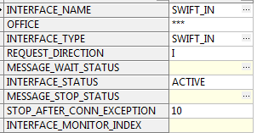
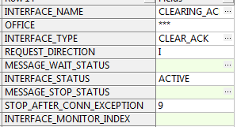
FROM SWIFT to local clearing ack
FX Engine
SWIFT
Receive Payment Instruction
Payment Initiation
Debit Side Processing
Credit Side Processing
Compliance
Account Lookup
Local Clearing
Posting
Balance Check
Fees Processing
MOP Selection Value Date and Cut Offs
Accounting System
Balance Inquiry

Slide 18
Asynchronous model
GPP send accounting information to Accounting Server, route payment message to MP_WAIT status until response will be received.
FX Engine
SWIFT
Receive Payment Instruction
Payment Initiation
Debit Side Processing
Credit Side Processing
Compliance
Account Lookup
Local Clearing
Posting
Balance Check
Fees Processing
MOP Selection Value Date and Cut Offs
Accounting System
Balance Inquiry

Slide 19
Request and Response

Slide 20


Transport protocol
MQ - MQ through JMS. Support to BACKOUT queues upon failures, depending upon load on particular channel, number of listeners can be configured.
WEB_SERVICE - SOAP over HTTP. Support for Soap 1.1 and Soap 1.2, security from server side as well as from client side, WS-Security
SOAP_JMS - SOAP over JMS
FILE - File drop
MQFTE1 - File transfer over MQ. MQFTE server is required at bank side
Email - Message with String attachment
SFTP2 - Secure File Transfer. SFTP server is required at bank side
Example - INTERFACE_TYPES table
GPP
GPP

Slide 21
Connection Point
The actual connection point to the external systems
Example - INTERFACE_TYPES table
JNDI name for the JMS resource (for MQ or SOAP _JMS)
Queue name (for MQ)
Web service end point (for WEB_SERVICE and SOAP _JMS)
Folder path (for FILE or SFTP)
GPP
GPP

Slide 22
Format Type
FULL - full (all existing message information) Funds Transfer Message is sent out in XML format
JSON – just Funds Transfer Message is sent out in JSON format
A subset of Funds Transfer Message (only a part of existing messages information) is sent out in the request
ACK_NOTIFY
Pain_012
CDB_OUT_CR_DEFAULT / CDB_OUT_DR_DEFAULT
PROPRIETRY - A proprietary structure defined for a specific customer . And now Funds Transfer Message mapped into the customer specific proprietary structured (handled by code and ☺ )
Example - INTERFACE_TYPES table
GPP
GPP

Slide 23
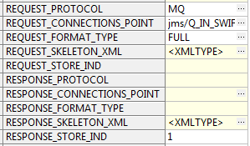
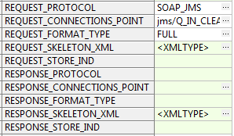
FROM SWIFT to local clearing ack
FX Engine
SWIFT
Receive Payment Instruction
Payment Initiation
Debit Side Processing
Credit Side Processing
Compliance
Account Lookup
Local Clearing
Posting
Balance Check
Fees Processing
MOP Selection Value Date and Cut Offs
Accounting System
Balance Inquiry

Slide 24
Asynchronous model
GPP send accounting information to Accounting Server, route payment message to MP_WAIT status until response will be received.
FX Engine
SWIFT
Receive Payment Instruction
Payment Initiation
Debit Side Processing
Credit Side Processing
Compliance
Account Lookup
Local Clearing
Posting
Balance Check
Fees Processing
MOP Selection Value Date and Cut Offs
Accounting System
Balance Inquiry

Slide 25
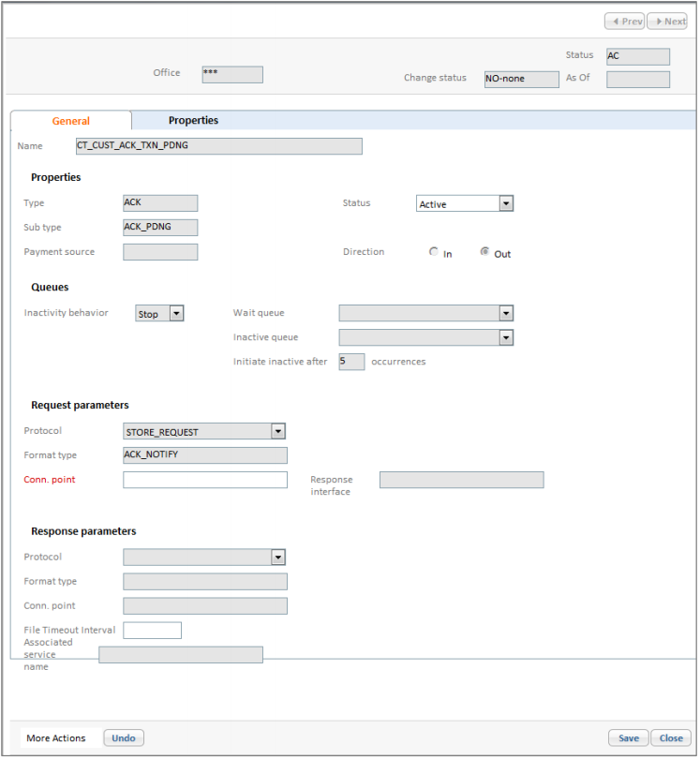
Interface Profile
User Interface Setup
The Interface profile in the user interface specifies, for example, the inactivity status, where payments are parked if the service is inactive, and the number of malfunction events that automate the service to Inactive status
Note: The only attributes that are open to GPP users are the interface status and the interface connection point.

Slide 26
Thank you
Alex Perman
Integration Team
alexander.perman@finastra.com

